Slide 1


Slide 2
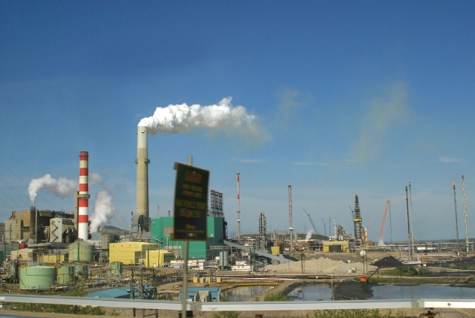
2
THE ECONOMIC
PROBLEM

Slide 3
After studying this chapter you will be able to
Define the production possibilities frontier and use it to calculate opportunity cost
Distinguish between production possibilities and preferences and define efficiency
Explain how current production choices expand future production possibilities
Explain how specialization and trade expand production possibilities
Copyright © 2013 Pearson Canada Inc., Toronto, Ontario

Slide 4
Why does food cost much more today than it did a few years ago?
One reason is that we now use part of our corn crop to produce ethanol, a clean biofuel substitute for gasoline.
Another reason is that drought in some parts of the world has decreased global grain production.
We use an economic model—the production possibilities frontier—to learn why ethanol production and drought have increased the cost of producing food.
We also use this model to study how we can expand our production possibilities.
Copyright © 2013 Pearson Canada Inc., Toronto, Ontario

Slide 5
Production Possibilities and Opportunity Cost
  The production possibilities frontier (PPF) is the boundary between those combinations of goods and services that can be produced and those that cannot.
  To illustrate the PPF, we focus on two goods at a time and hold the quantities of all other goods and services constant.
  That is, we look at a model economy in which everything remains the same (ceteris paribus) except the two goods we’re considering.
Copyright © 2013 Pearson Canada Inc., Toronto, Ontario

Slide 6
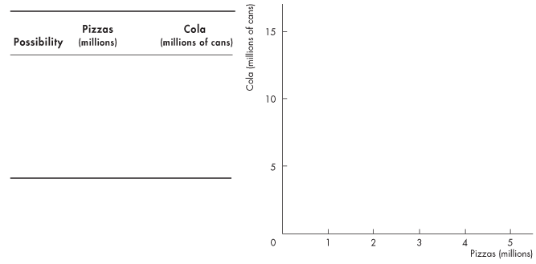
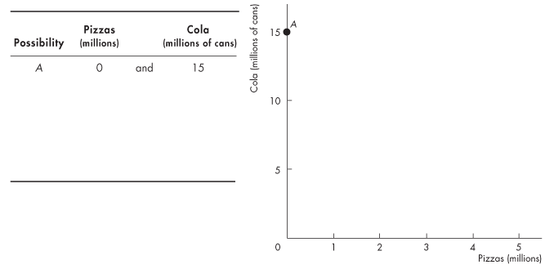
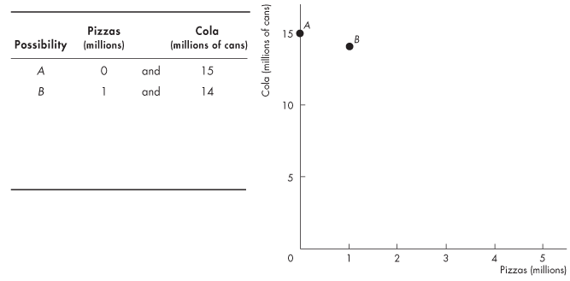
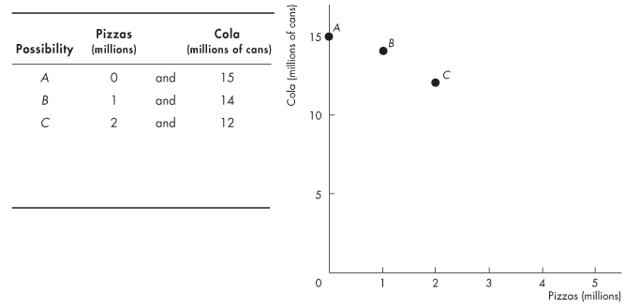
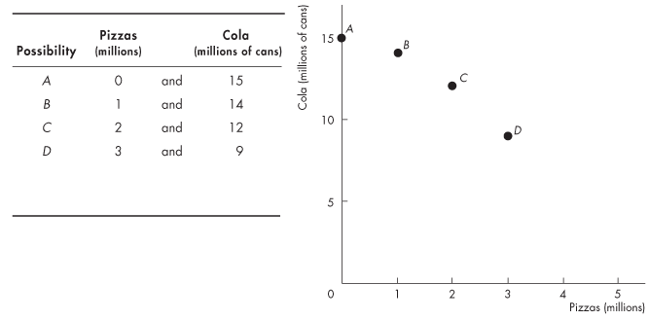
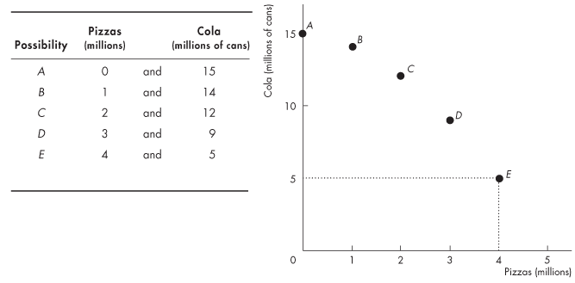
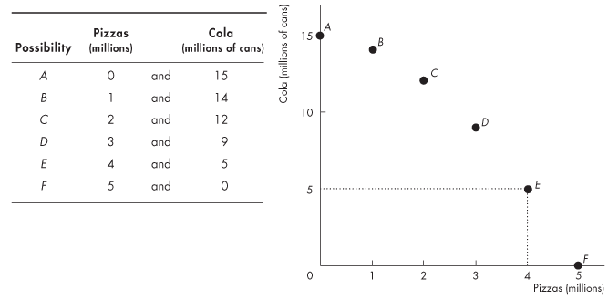
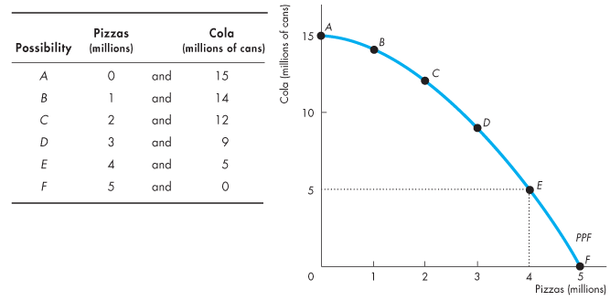
Production Possibilities and Opportunity Cost
Production Possibilities Frontier
  Figure 2.1 shows the PPF for two goods: cola and pizzas.
Copyright © 2013 Pearson Canada Inc., Toronto, Ontario

Slide 7
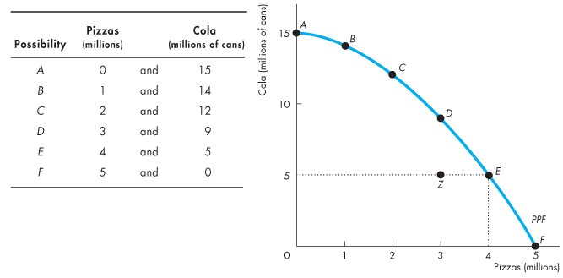
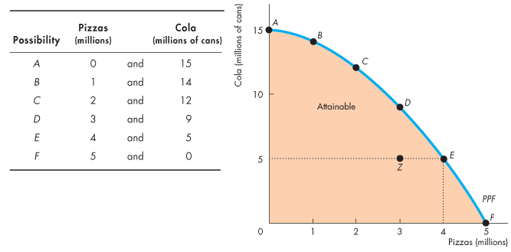
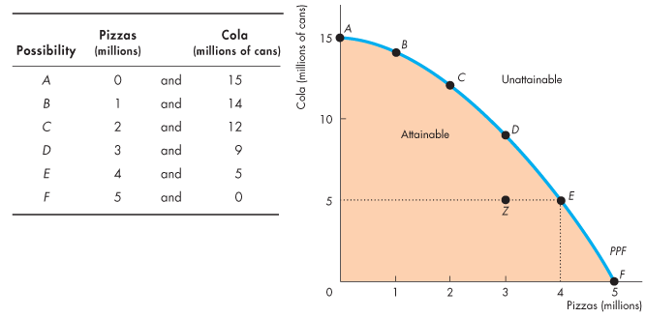
Production Possibilities and Opportunity Cost
  Any point on the frontier such as E and any point inside the PPF such as Z are attainable.
  Points outside the PPF are unattainable.
Copyright © 2013 Pearson Canada Inc., Toronto, Ontario

Slide 8
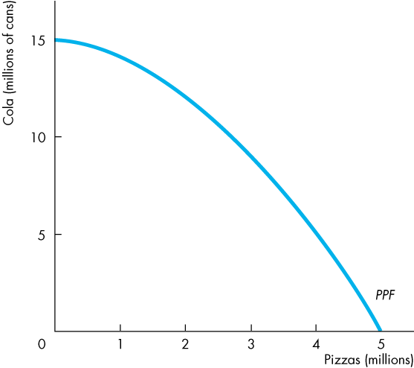
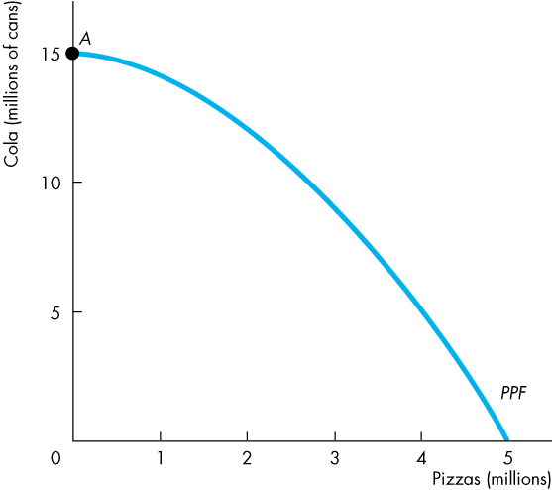
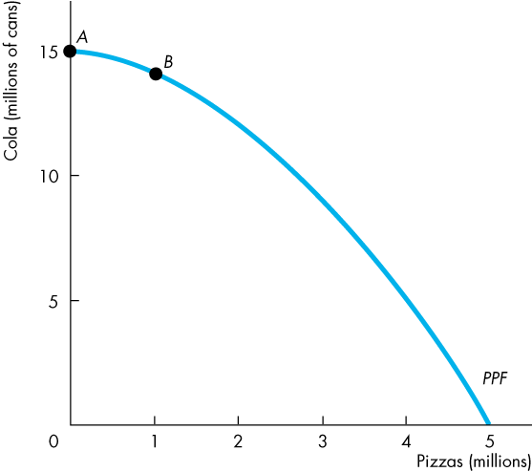
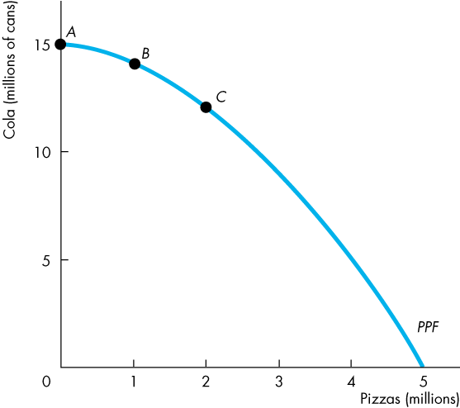
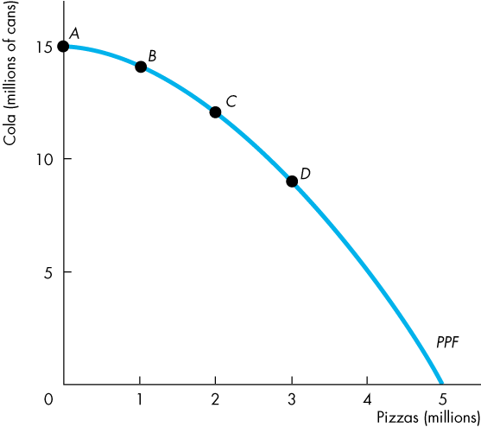
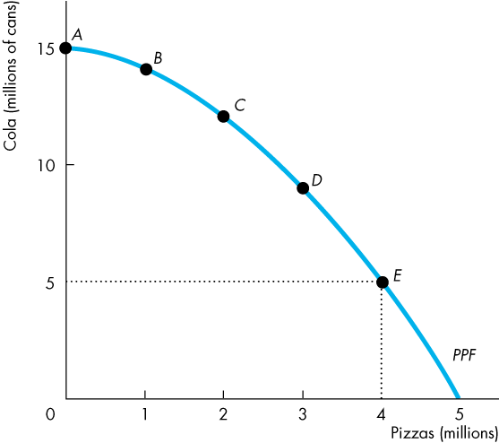
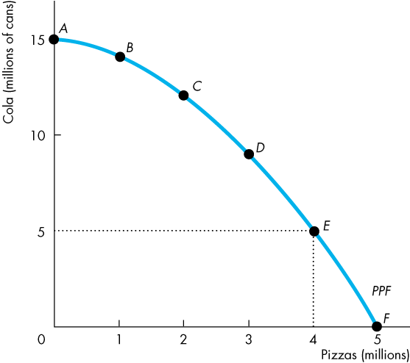
Production Possibilities and Opportunity Cost
Production Efficiency
  We achieve production efficiency if we cannot produce more of one good without producing less of some other good.
  Points on the frontier are efficient.
Copyright © 2013 Pearson Canada Inc., Toronto, Ontario

Slide 9
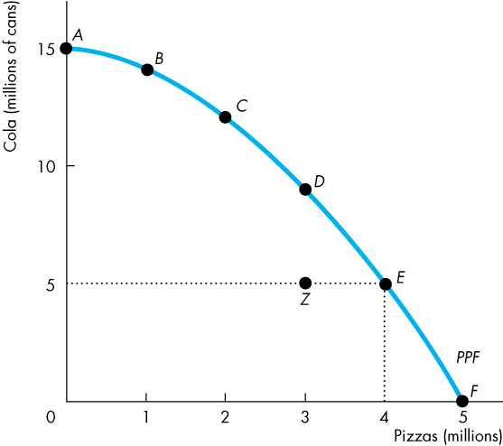
Production Possibilities and Opportunity Cost
  Any point inside the frontier, such as Z, is inefficient.
  At such a point, it is possible to produce more of one good without producing less of the other good.
  At Z, some resources are either unemployed or misallocated.
Copyright © 2013 Pearson Canada Inc., Toronto, Ontario

Slide 10
Production Possibilities and Opportunity Cost
Tradeoff Along the PPF
  Every choice along the PPF involves a tradeoff.
  On this PPF, we must give up some cola to get more pizzas or give up some pizzas to get more cola.
Copyright © 2013 Pearson Canada Inc., Toronto, Ontario

Slide 11
Production Possibilities and Opportunity Cost
Opportunity Cost
  As we move down along the PPF,
  we produce more pizzas, but the quantity of cola we can produce decreases.
  The opportunity cost of a pizza is the cola forgone.
Copyright © 2013 Pearson Canada Inc., Toronto, Ontario

Slide 12
Production Possibilities and Opportunity Cost
  In moving from E to F:
  The quantity of pizzas increases by 1 million.
  The quantity of cola decreases by 5 million cans.
  The opportunity cost of the fifth 1 million pizzas is
  5 million cans of cola.
  One of these pizzas costs 5 cans of cola.
Copyright © 2013 Pearson Canada Inc., Toronto, Ontario

Slide 13
Production Possibilities and Opportunity Cost
  In moving from F to E:
  The quantity of cola increases by 5 million cans.
  The quantity of pizzas decreases by 1 million.
  The opportunity cost of the first 5 million cans of cola is 1 million pizzas.
  One of these cans of cola costs 1/5 of a pizza.
Copyright © 2013 Pearson Canada Inc., Toronto, Ontario

Slide 14
Production Possibilities and Opportunity Cost
  Opportunity Cost Is a Ratio
  Note that the opportunity cost of a can of cola is the inverse of the opportunity cost of a pizza.
  One pizza costs 5 cans of cola.
  One of these cans of cola costs 1/5 of a pizza.
Copyright © 2013 Pearson Canada Inc., Toronto, Ontario

Slide 15
Production Possibilities and Opportunity Cost
  Increasing Opportunity Cost
  Because resources are not equally productive in all activities, the PPF bows outward.
  The outward bow of the PPF means that as the quantity produced of each good increases, so does its opportunity cost.
PPF is the boundary, any point inside the PPF is possible, the points on the PPF is the maximum
Copyright © 2013 Pearson Canada Inc., Toronto, Ontario

Slide 16
Using Resources Efficiently
  All the points along the PPF are efficient.
  To determine which of the alternative efficient quantities to produce, we compare costs and benefits.
The PPF and Marginal Cost
  The PPF determines opportunity cost.
  The marginal cost of a good or service is the opportunity cost of producing one more unit of it.
Copyright © 2013 Pearson Canada Inc., Toronto, Ontario

Slide 17
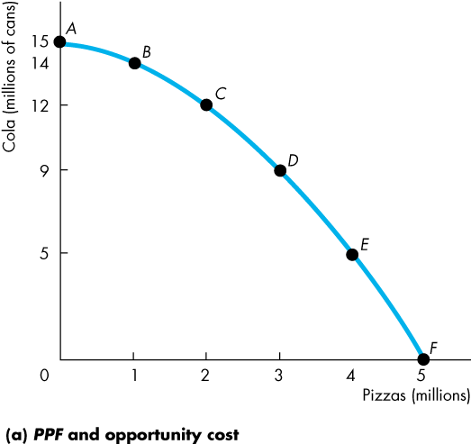
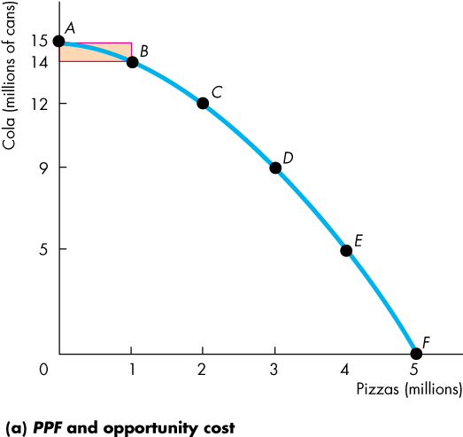
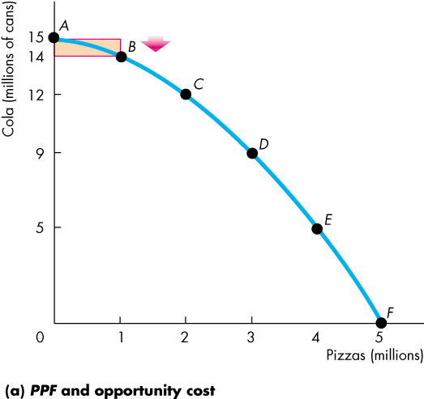
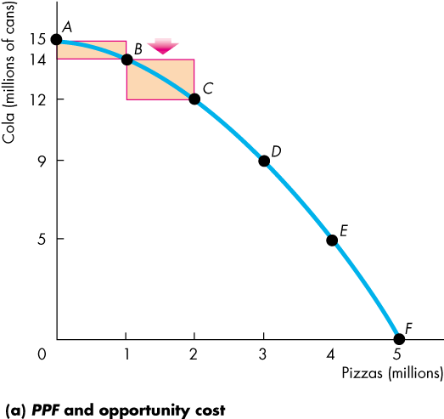
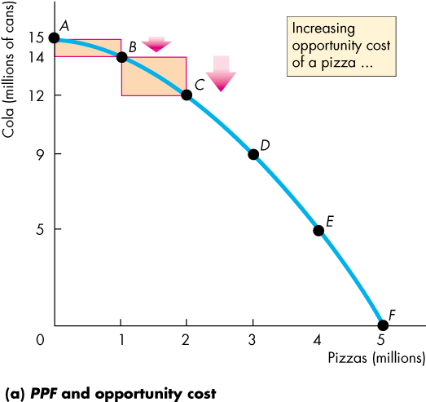
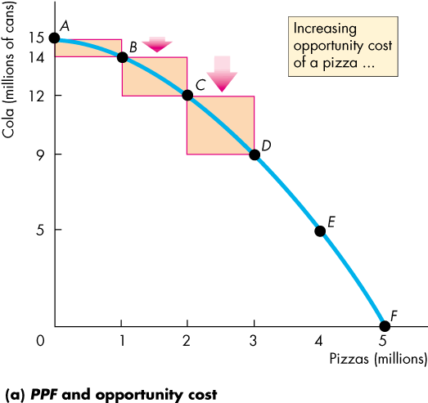
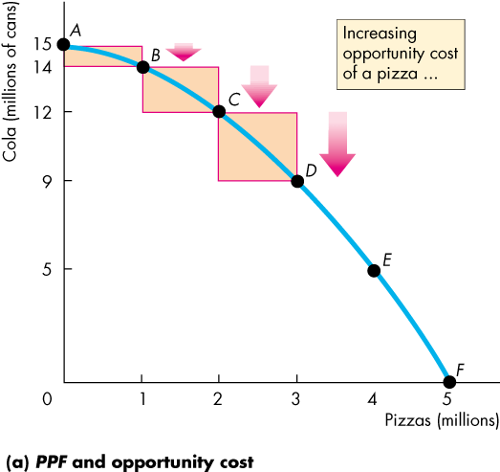
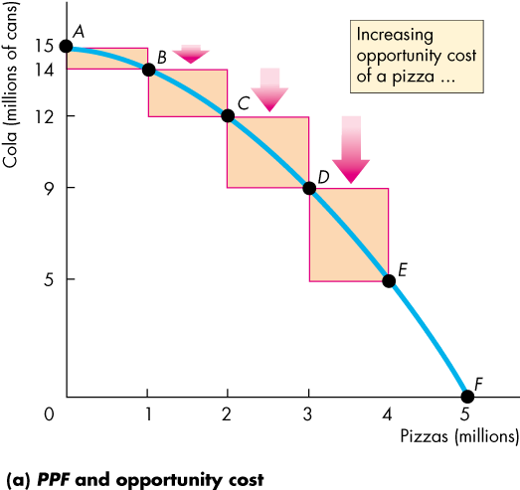
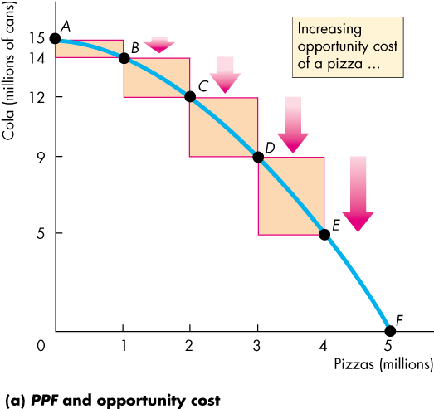
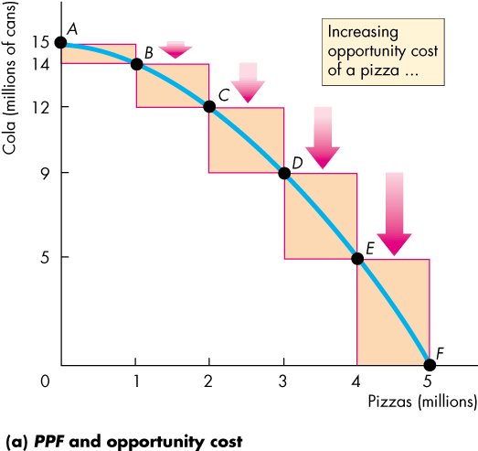
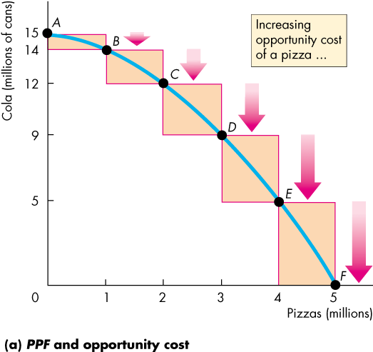
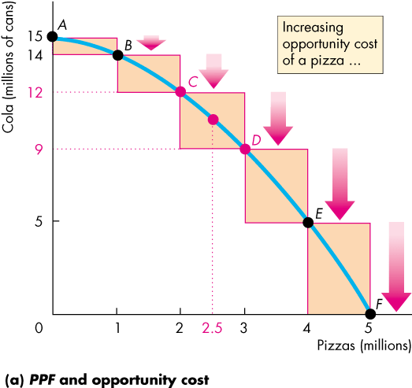
Using Resources Efficiently
  Figure 2.2 illustrates the marginal cost of a pizza.
  As we move along the PPF, the opportunity cost of a pizza increases.
  The opportunity cost of producing one more pizza is the marginal cost of a pizza.
Copyright © 2013 Pearson Canada Inc., Toronto, Ontario

Slide 18
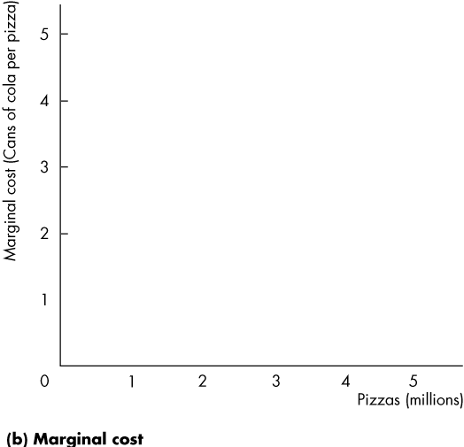
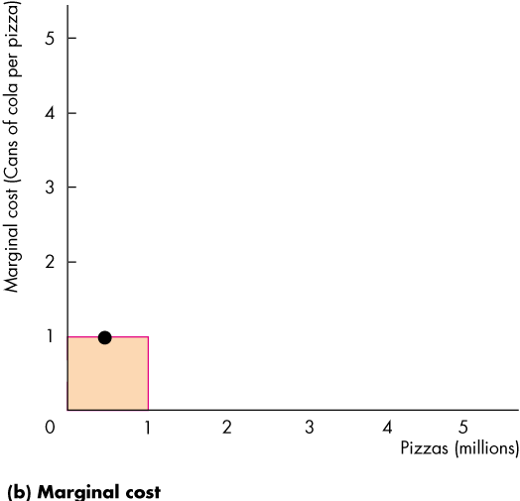
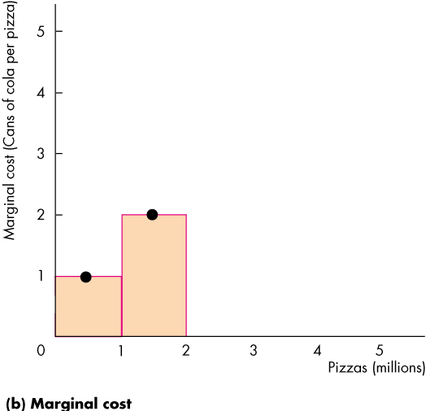
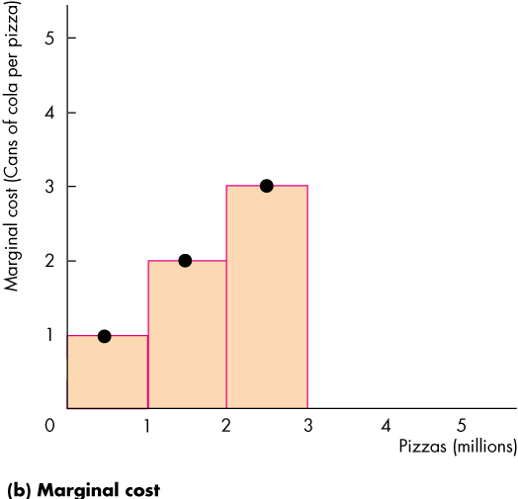
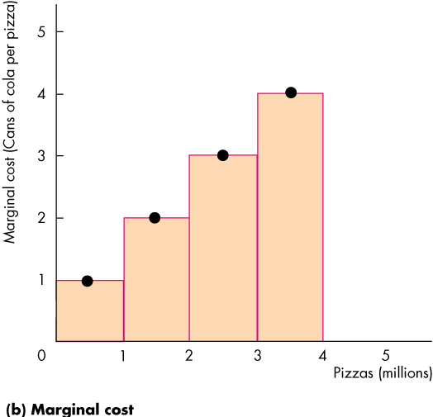
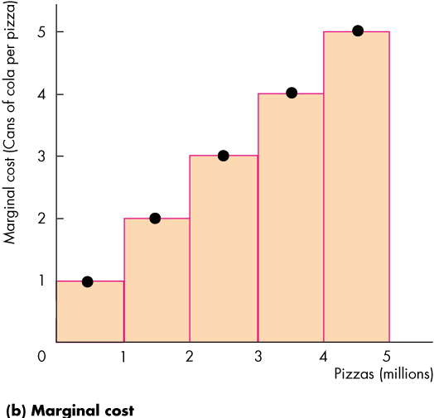
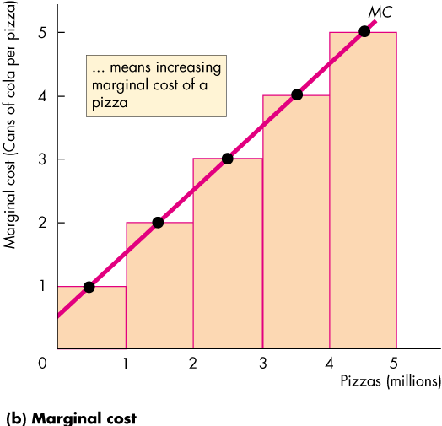

Using Resources Efficiently
  In part (b) of Fig. 2.2, the bars illustrate the increasing opportunity cost of a pizza.
  The black dots and the line MC show the marginal cost of producing a pizza.
  The MC curve passes through the center of each bar.
Copyright © 2013 Pearson Canada Inc., Toronto, Ontario

Slide 19
Using Resources Efficiently
Preferences and Marginal Benefit
  Preferences are a description of a person’s likes and dislikes.
  To describe preferences, economists use the concepts of marginal benefit and the marginal benefit curve.
  The marginal benefit of a good or service is the benefit received from consuming one more unit of it.
  We measure marginal benefit by the amount that a person is willing to pay for an additional unit of a good or service.
Copyright © 2013 Pearson Canada Inc., Toronto, Ontario
Notes:
Preference create the demand.
Marginal benefit become less and less if the more goods have been produced, because the demand have been decreased as the more production have been produced.
The most

Slide 20
Using Resources Efficiently
  It is a general principle that:
  The more we have of any good, the smaller is its marginal benefit and …
  the less we are willing to pay for an additional unit of it.
  We call this general principle the principle of decreasing marginal benefit.
  The marginal benefit curve shows the relationship between the marginal benefit of a good and the quantity of that good consumed.
Copyright © 2013 Pearson Canada Inc., Toronto, Ontario

Slide 21
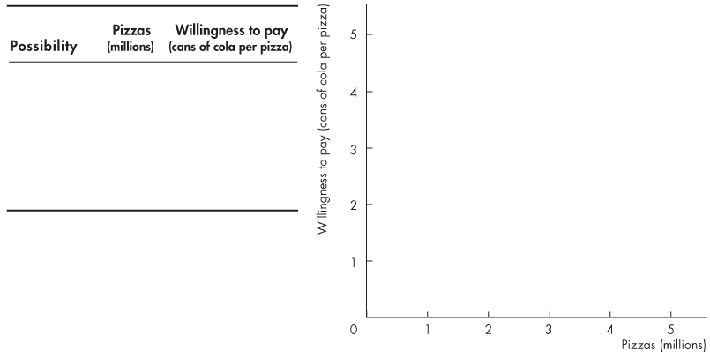
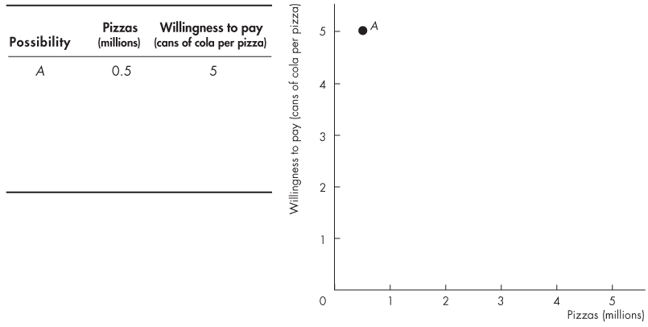
Using Resources Efficiently
  At point A, with 0.5 million pizzas available, people are willing to pay 5 cans of cola for a pizza.
  .
Copyright © 2013 Pearson Canada Inc., Toronto, Ontario

Slide 22
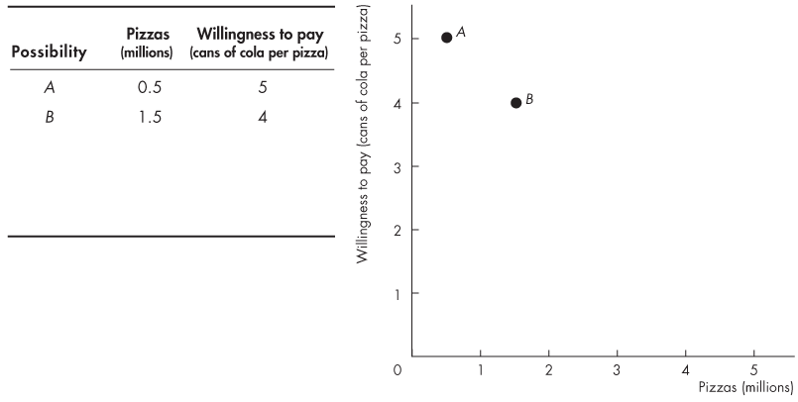
Using Resources Efficiently
  At point B, with pizza 1.5 million pizzas available, people are willing to pay 4 cans of cola for a pizza
Copyright © 2013 Pearson Canada Inc., Toronto, Ontario

Slide 23
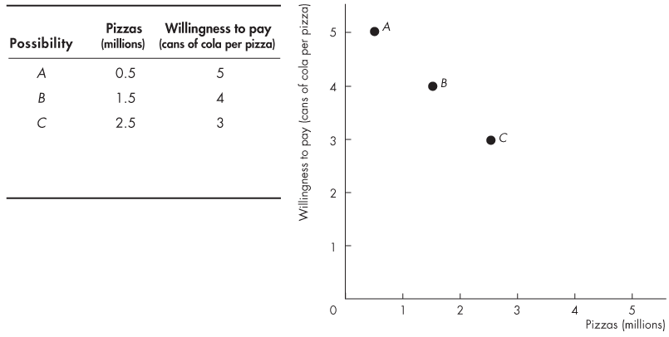
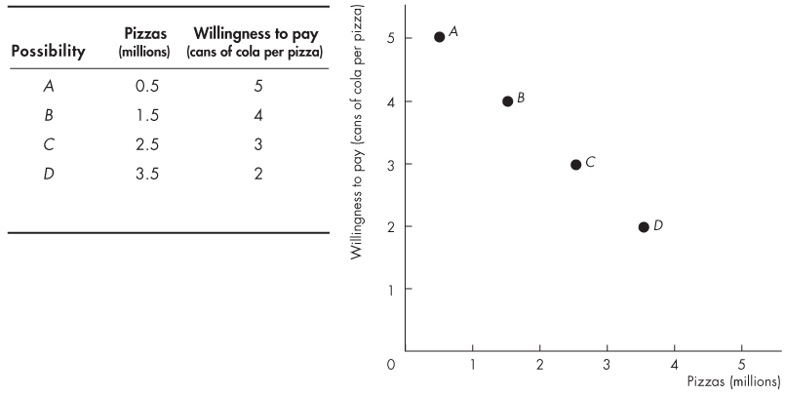
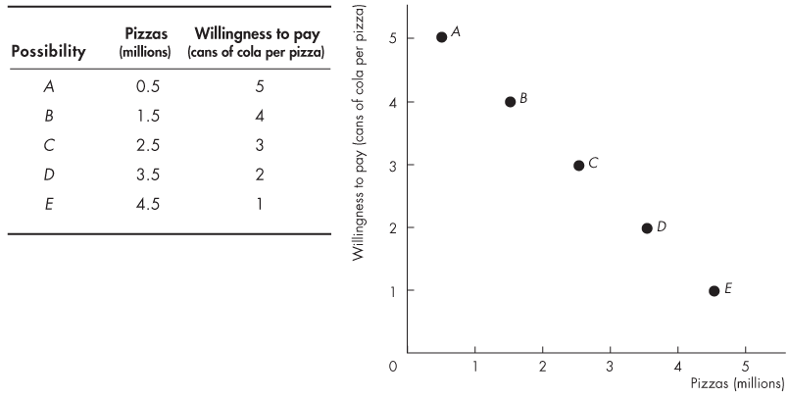
Using Resources Efficiently
  At point E, with pizza 4.5 million pizzas available, people are willing to pay 1 can of cola for a pizza.
Copyright © 2013 Pearson Canada Inc., Toronto, Ontario
Notes:
The more pizza they have, the less marginal benefit they get from an extra unit.

Slide 24
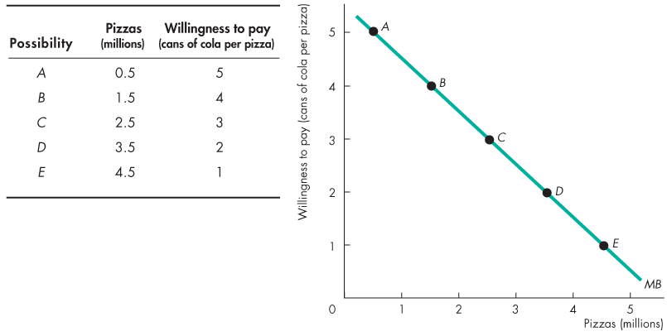
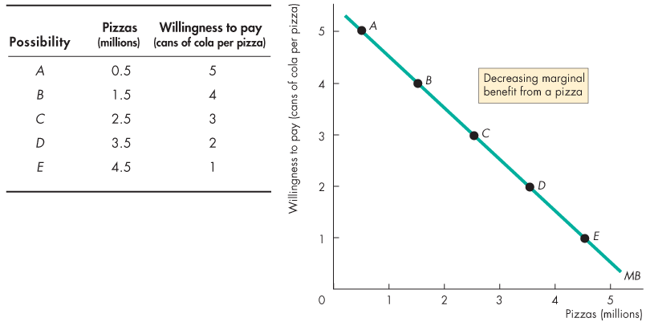
Using Resources Efficiently
  The line through the points shows the marginal benefit from a pizza.
Copyright © 2013 Pearson Canada Inc., Toronto, Ontario

Slide 25
Using Resources Efficiently
Allocative Efficiency
  When we cannot produce more of any one good without giving up some other good, we have achieved production efficiency.
  We are producing at a point on the PPF.
  When we cannot produce more of any one good without giving up some other good that we value more highly, we have achieved allocative efficiency.
  We are producing at the point on the PPF that we prefer above all other points.
Copyright © 2013 Pearson Canada Inc., Toronto, Ontario
Notes:
Allocate efficiency is the efficiency you produce goods, is cannot be called as produce effiency.

Slide 26
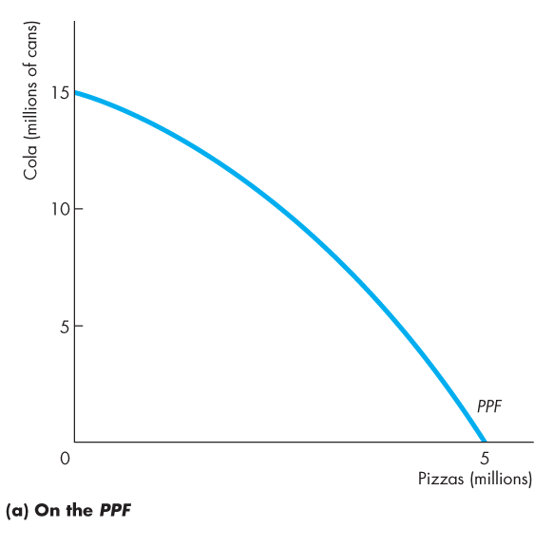
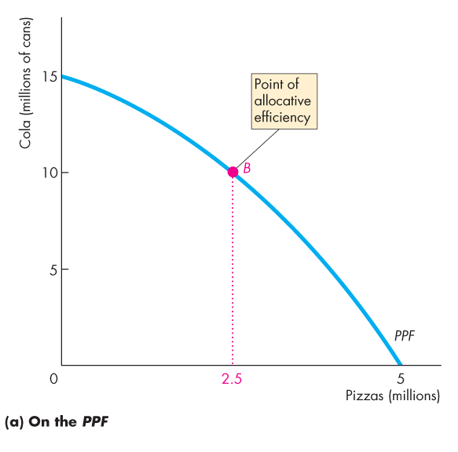
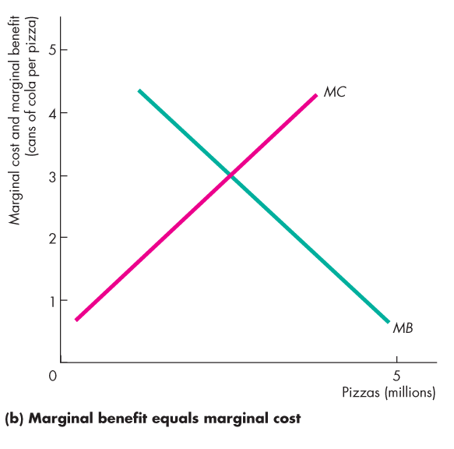

Using Resources Efficiently
  Figure 2.4 illustrates allocative efficiency.
  The point of allocative efficiency is the point on the PPF at which marginal benefit equals marginal cost.
  This point is determined by the quantity at which the marginal benefit curve intersects the marginal cost curve.
Copyright © 2013 Pearson Canada Inc., Toronto, Ontario
Notes:
Is it worthwhile for the society to produce the goods or service？
At the point where MC = MB, the benefit comes the maximum, but once the production is more than the point, the benefit comes down.
As the production goes up, the net benefit goes down until it comes to zero.
To get the maximum of the benefit in the PPF, the graph of the allocated efficency is required.

Slide 27




Using Resources Efficiently
  If we produce fewer than 2.5 million pizzas, marginal benefit exceeds marginal cost.
  We get more value from our resources by producing more pizzas.
  On the PPF at point A, we are producing too few pizzas.
  We are better off moving along the PPF to produce more pizzas.
Copyright © 2013 Pearson Canada Inc., Toronto, Ontario

Slide 28





Using Resources Efficiently
  If we produce more than 2.5 million pizzas, marginal cost exceeds marginal benefit.
  We get more value from our resources by producing fewer pizzas.
  On the PPF at point C, we are producing too many pizzas.
  We are better off moving along the PPF to produce fewer pizzas.
Copyright © 2013 Pearson Canada Inc., Toronto, Ontario

Slide 29












Using Resources Efficiently
  On the PPF at point B, we are producing the efficient quantities of pizzas and cola.
  If we produce exactly 2.5 million pizzas, marginal cost equals marginal benefit.
  We cannot get more value from our resources.
Copyright © 2013 Pearson Canada Inc., Toronto, Ontario

Slide 30
Economic Growth
  The expansion of production possibilities—and increase in the standard of living—is called economic growth.
  Two key factors influence economic growth:
  Technological change
  Capital accumulation
  Technological change is the development of new goods and of better ways of producing goods and services.
  Capital accumulation is the growth of capital resources, which includes human capital.
Copyright © 2013 Pearson Canada Inc., Toronto, Ontario
Notes:
Capital includes:
Human capital: skilled workers
Physical capital: money, machines

Slide 31
Economic Growth
  The Cost of Economic Growth
  To use resources in research and development and to produce new capital, we must decrease our production of consumption goods and services.
  So economic growth is not free.
  The opportunity cost of economic growth is less current consumption.
Copyright © 2013 Pearson Canada Inc., Toronto, Ontario

Slide 32


Economic Growth
  Figure 2.5 illustrates the tradeoff we face.
  We can produce pizzas or pizza ovens along PPF₀.
  By using some resources to produce pizza ovens today, the PPF shifts outward in the future.
Copyright © 2013 Pearson Canada Inc., Toronto, Ontario

Slide 33
Gains from Trade
Comparative Advantage and Absolute Advantage
  A person has a comparative advantage in an activity if that person can perform the activity at a lower opportunity cost than anyone else.
  A person has an absolute advantage if that person is more productive than others.
  Absolute advantage involves comparing productivities while comparative advantage involves comparing opportunity costs.
  Let’s look at Liz and Joe who operate smoothie bars.
Copyright © 2013 Pearson Canada Inc., Toronto, Ontario

Slide 34
Gains from Trade
Joe's Smoothie Bar
In an hour, Joe can produce 6 smoothies or 30 salads.
Joe’s ability to make smoothies and salads is the same regardless of how he divides his time between the two tasks (his PPF is linear, not outward bowed).
Joe's opportunity cost of producing 1 smoothie is 5 salads. Joe's opportunity cost of producing 1 salad is 1/5 smoothie.
Joes’ customers buy salads and smoothies in equal number, so he produces 5 smoothies and 5 salads an hour (at point A on his PPF).
Copyright © 2013 Pearson Canada Inc., Toronto, Ontario
Notes:
Joe’s customers also buy salads and smoothies in equal number.

Slide 35

Gains from Trade
Copyright © 2013 Pearson Canada Inc., Toronto, Ontario

Slide 36
Gains from Trade
Liz's Smoothie Bar
In an hour, Liz can produce 30 smoothies or 30 salads.
Liz’s ability to make smoothies and salads is the same regardless of how she divides her time between the two tasks (her PPF is linear, not outward bowed).
Liz's opportunity cost of producing 1 smoothie is 1 salad, and her opportunity cost of producing 1 salad is 1 smoothie.
Liz’s customers also buy salads and smoothies in equal number, so she produces 15 smoothies and 15 salads an hour (at point A on her PPF).
Copyright © 2013 Pearson Canada Inc., Toronto, Ontario

Slide 37
Gains from Trade
    Absolute Advantage
    Liz has an absolute advantage (is more productive) in producing smoothies per hour.
    Joe and Liz are equally productive in producing salads per hour.
Copyright © 2013 Pearson Canada Inc., Toronto, Ontario

Slide 38
Gains from Trade
  Liz’s Comparative Advantage
  Liz’s opportunity cost of a smoothie is 1 salad.
  Joe’s opportunity cost of a smoothie is 5 salads.
  Liz has a comparative advantage (lower opportunity cost) in producing smoothies.
Copyright © 2013 Pearson Canada Inc., Toronto, Ontario

Slide 39
Gains from Trade
Joe’s Comparative Advantage
  Joe’s opportunity cost of a salad is 1/5 smoothie.
  Liz’s opportunity cost of a salad is 1 smoothie.
  Joe has a comparative advantage (lower opportunity cost) in producing salads.
Copyright © 2013 Pearson Canada Inc., Toronto, Ontario

Slide 40
Gains from Trade
Specialization
  By specializing in producing the good in which they have a comparative advantage and then trading at a price between their two opportunity costs, Joe and Liz can move to a point outside their PPF (that is, gain smoothies and salads each with no extra resources).
  So Liz produces 30 smoothies and 0 salads (at point B on her PPF), and Joe produces 30 salads and 0 smoothies (at point B on his PPF).
Copyright © 2013 Pearson Canada Inc., Toronto, Ontario

Slide 41

Gains from Trade
Copyright © 2013 Pearson Canada Inc., Toronto, Ontario

Slide 42
Gains from Trade
  Trade Agreement
  Liz offers to sell Joe 10 smoothies in exchange for 20 salads (equivalently, Joe offers to sell Liz 20 salads in exchange for 10 smoothies).
  They trade salads for smoothies along the red “Trade line.”
  The trade price of a salad (1/2 of a smoothie) lies between Joe’s price of a salad (1/5 of a smoothie) and Liz’s price of a salad (1 smoothie).
  Equivalently, the trade price of a smoothie (2 salads) lies between Joe’s price of a smoothie (5 salads) and Liz’s price of a smoothie (1 salad).
Copyright © 2013 Pearson Canada Inc., Toronto, Ontario

Slide 43
Gains from Trade
  The opportunity cost of a salad for Liz is now only ½ of a smoothie rather than 1 smoothie.
  The opportunity cost of a smoothie for Joe is now only 2 salads rather than 5 salads.
  The trade price is a good deal for both Liz and Joe.
  Note: Liz and Joe will be willing to trade only if the ‘price’ of the good each person obtains in trade is less than its own opportunity cost of producing the good themselves. This is a general statement that is true whenever two parties – individuals, firms, or countries - trade voluntarily.
Copyright © 2013 Pearson Canada Inc., Toronto, Ontario

Slide 44







Gains from Trade
  Joe buys smoothies from Liz and moves to point C—a point outside his PPF.
  Liz buys salads from Joe and moves to point C—a point outside her PPF.
Copyright © 2013 Pearson Canada Inc., Toronto, Ontario

Slide 45
Gains from Trade
  After trade:
    Liz has 20 smoothies and 20 salads.
    Joe has 10 smoothies and 10 salads
  Gains from trade:
    Liz gains 5 smoothies and
    5 salads an hour
    Joe gains 5 smoothies and 5 salads an hour
    Liz and Joe both gain without using extra resources
Copyright © 2013 Pearson Canada Inc., Toronto, Ontario

Slide 46
Gains from Trade
  Crucially, it doesn’t matter if, say, Liz is actually better than Joe at production of both goods. In that case, Liz has an absolute advantage in both goods. You might be tempted to think that in that case Liz has nothing to gain from trading with Joe.
  But we’ve just seen that Liz can indeed benefit from trading with Joe because comparative, not absolute, advantage is the basis for mutual gains from trade.
Copyright © 2013 Pearson Canada Inc., Toronto, Ontario

